Slide 1
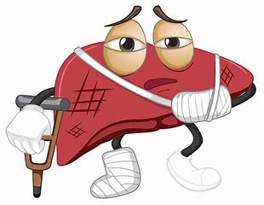
PROJECT
LIVER DISEASE PREDICTION USING MACHINE LEARNING

Slide 2
BUSINESS OBJECTIVE
The variable to be predicted is categorical
(No disease, suspect disease, hepatitis c, fibrosis, cirrhosis).
Therefore, this is a classification project.

Slide 3
Project Contents-
EDA
Model building
Model Evaluation
Deployment
Final Presentation

Slide 4
DATA DESCRIPTION
The number of instances (rows) in the data set is 615, and the number of variables (columns) is 13. Nearly all input variables are numeric-valued except one, Sex, which is binary, and most of them represent measurements from blood and urine analysis. The following list summarizes the variables information:
Category:
Age
Sex
Albumin
Alkaline phosphatase
Alanine aminotransferase
Aspartate aminotransferase
8. Bilirubin
9. Cholinesterase
10. Cholesterol
11. Creatinina
12. Gamma_glutamyl_transferase
13. Protein

Slide 5
EXPLORARTORY DATA ANALYSIS
The dataset consists of 615 records related to liver diseases, with 13 columns. These include both categorical and numerical data, such as 'category', 'age', 'sex', and various medical test results. The columns include 'category' (object type), 'age' (int64), 'sex' (object type), and other medical measures like 'albumin', 'Alkaline Phosphatase', 'Alanine Aminotransferase', etc., with some columns having missing values that were handled during preprocessing
We will convert the 'protein' column from an object data type to a float data type, as it contains numerical values
To address the missing or null values, we examined potential outliers in the data by using a boxplot analysis
We checked for duplicate values in the dataset and confirmed that there are none
The analysis revealed the presence of outliers in the dataset, so we replaced the missing values with the median values of the respective columns
Upon checking for missing or null values, we found that the 'albumin' column has 1 missing value, 'Alkaline Phosphatase' has 18 missing values, 'Alanine Aminotransferase' has 1 missing value, 'cholesterol' has 10 missing values, and 'protein' has 1 Missing value
There are two categorical columns in the dataset, which we converted into numerical values. For instance, we mapped 'f' to 0 and 'm' to 1, and used label encoding to transform the 'category' column into numeric form.
We have used a delimiter to separate the data, as it was not in a properly organized format

Slide 6
EXPLORARTORY DATA ANALYSIS
Capping Technique:
Handling Missing Values:
Outlier Replacement:
Outlier values are replaced with the upper or lower extreme values.
Columns with missing values include: 'albumin' (1 missing value)
For these columns, the upper and lower extreme values were identified.
Values above the upper extreme are replaced by the upper extreme value.
'Alkaline phosphatase' (18 missing values)
Outliers were then replaced with the appropriate extreme values, ensuring data consistency and quality for further analysis.
'alanine_aminotransferase' (1 missing value)
Values below the lower extreme are replaced by the lower extreme value.
'cholesterol' (10 missing values)

Slide 7
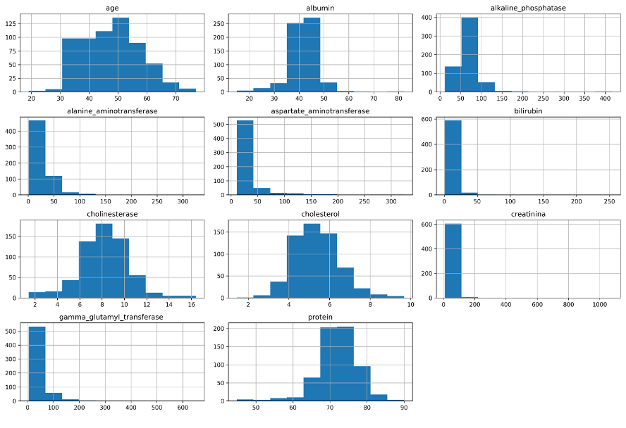
HISTOGRAM
Alkaline Phosphatase, Alanine Aminotransferase, Aspartate Aminotransferase, Bilirubin, Creatinine, and Gamma Glutamyl Transferase are heavily right-skewed with notable outliers.
Most patients are around middle age, as shown in the Age histogram
This distribution analysis highlights where normalization or outlier treatment may be needed for better modeling.
Columns like Creatinine and Gamma Glutamyl Transferase have extreme outliers, indicating highly varied levels among patients.
Age, Albumin, Cholinesterase, Cholesterol, and Protein columns show roughly normal distributions

Slide 8
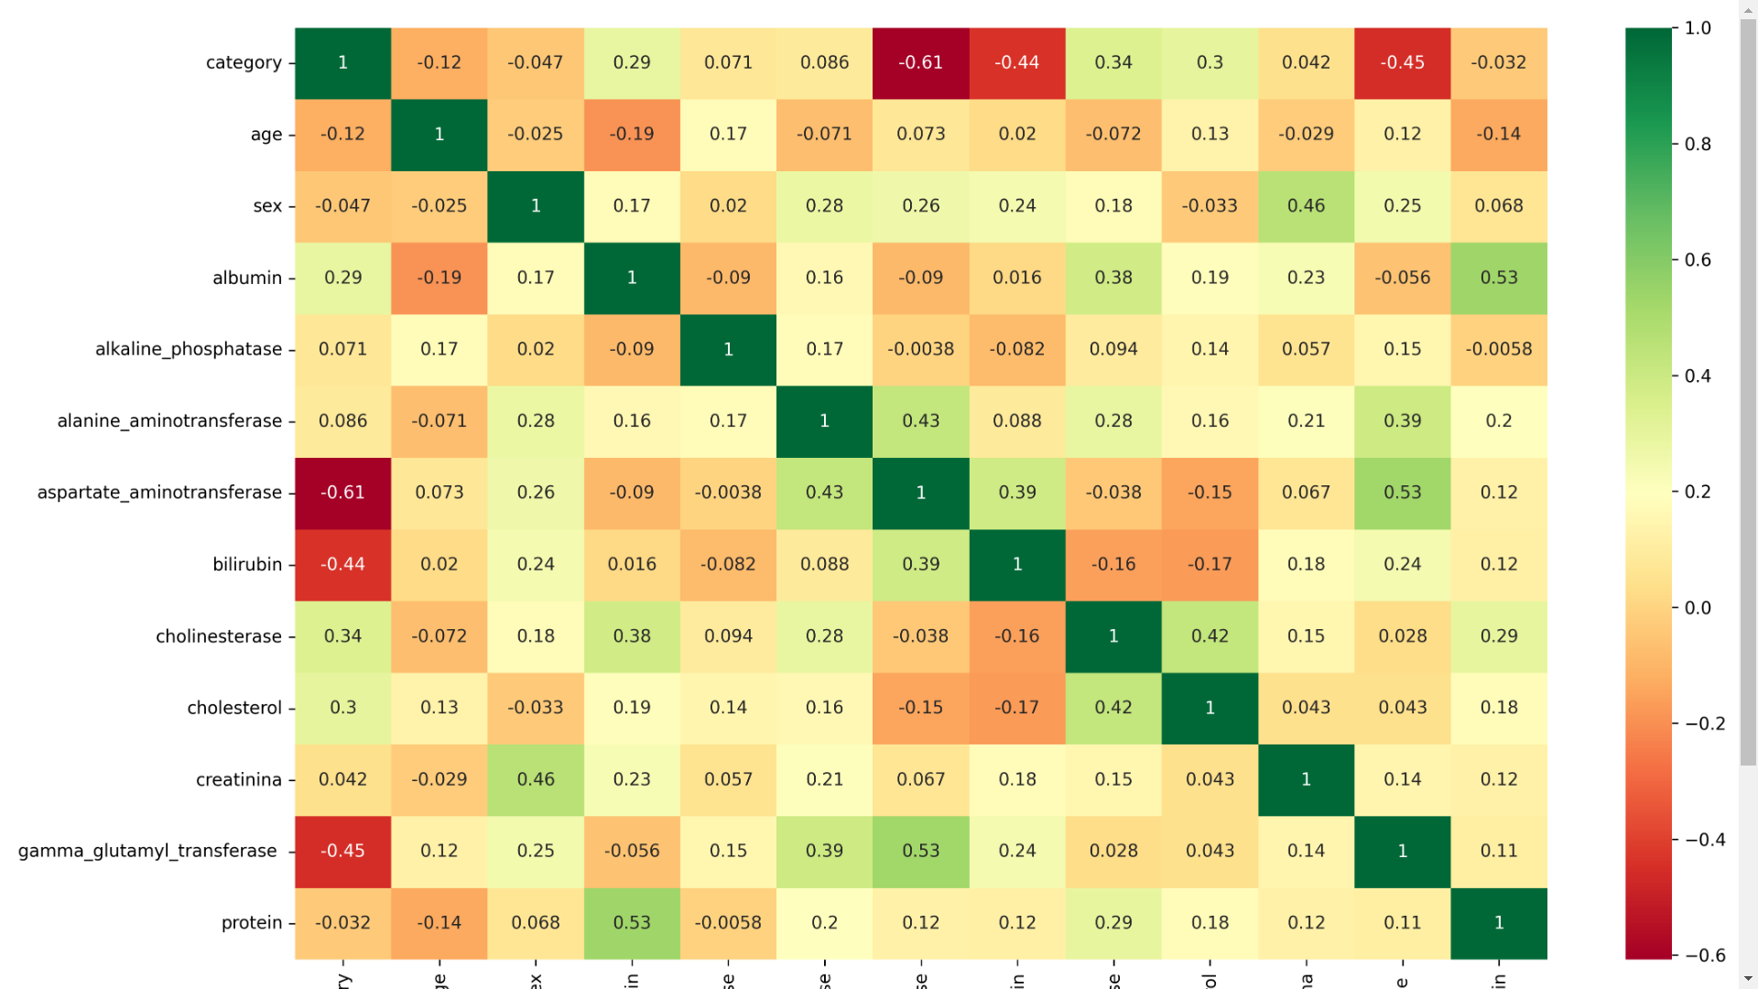
HEATMAP
Color Intensity: The color scale (red to green) represents correlation strength; red shows strong negative correlations, green shows strong positive correlations, and yellow indicates weak or no correlation
Diagonal Line: All diagonal elements are 1, as each variable is perfectly correlated with itself
Insightful Clusters: Groups like liver enzymes (alanine aminotransferase, aspartate aminotransferase, bilirubin) display interrelated patterns, useful for domain-specific analysis
Key Negative Correlations: Variables like category and aspartate aminotransferase -0.61) or category and bilirubin -0.44) show significant negative relationships
Key Positive Correlations: Strong positive correlations include protein with albumin (0.53) and aspartate aminotransferase with alanine aminotransferase (0.43)

Slide 9
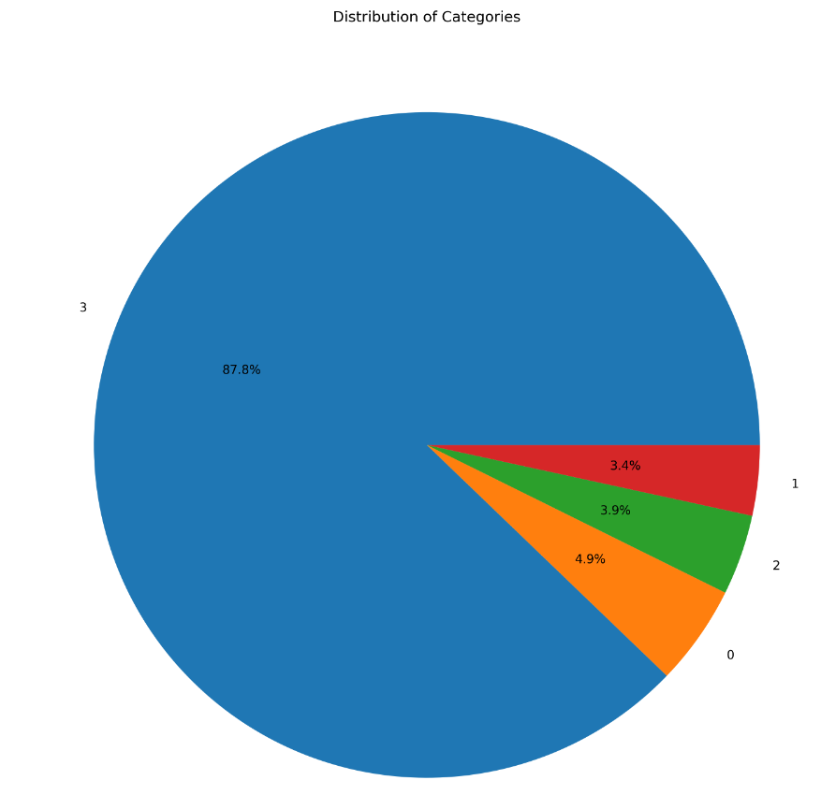
PIE CHART
Category Distribution: The majority of cases fall under category 3 (no disease), representing 87.8% of the dataset.
Hepatitis (Category 2): Accounts for 3.9% of the dataset, slightly more frequent than fibrosis.
Cirrhosis (Category 0): Comprises 4.9% of the data, indicating a small but significant subset of cases with cirrhosis.
Imbalance in Categories: The dataset is highly imbalanced, with a dominant proportion of healthy cases (category 3), which may influence model performance in classification tasks.
Fibrosis (Category 1): Represents 3.4% of the data, showing fewer cases with fibrosis compared to cirrhosis.

Slide 10
MODEL BUILDING
For model building, we explored multiple algorithms to find the one with the best accuracy
Models Used: We evaluated 7 different models:
Logistic Regression
Decision Tree Classifier
Random Forest Classifier
Gradient Boosting Classifier
XGBM Classifier
K-Nearest Neighbours (KNN)
Support Vector Machine (SVM)
Evaluation Metrics: Each model was assessed based on its accuracy and other relevant performance metrics.
Result: The model with the highest accuracy and stability was selected as the best model.
We split the dataset into training and testing sets, with 67% used for training and 33% for testing. We used train_test_split with a test_ size of 0.33, and set random_state=42 to ensure consistent results

Slide 11
Logistic Regression
To implement and evaluate the Logistic Regression model, we followed these steps:
Model Initialization: Created a Logistic Regression model using Logistic Regression().
Model Training: Trained the model using the training data with model1.fit(x_train, y_train).
Prediction: Generated predictions on the test data using y_predict1 = model1.predict(x_test).
Result Comparison: Created a Data Frame (df1) to compare the actual vs. predicted values
This is the confusion matrix
[[ 8 3 0 1]
[ 0 2 2 4]
[ 1 1 6 3]
[ 1 1 0 170]]
The model correctly predicted No Disease (3) 8 times, Cirrhosis (0) 2 times, Hepatitis (2) 6 times, and Fibrosis (1) 170 times.
It incorrectly predicted Cirrhosis (0) as Hepatitis (2) 2 times and Fibrosis (1) as Cirrhosis (0) once.
No Disease (3) was misclassified as Cirrhosis (0) 3 times, and Hepatitis (2) was misclassified as Cirrhosis (0) once.
Fibrosis (1) was misclassified as Hepatitis (2) 3 times, indicating some confusion between the two classes.
The training accuracy of the model is 97.33%, meaning it correctly classified 97.33% of the training data.
The testing accuracy of the model is 91.63%, indicating it correctly classified 91.63% of the testing data.
Overall, the model shows high performance in classifying both the training and testing data.

Slide 12
XGBM Classifier
Hyperparameter tuning was conducted on an XGBoost Classifier using GridSearchCV to optimize its performance on the dataset.
The tuning parameters included:
n_estimators: 90, 110, 150, which sets the number of boosting rounds.
learning_rate: 0.5, 0.7, and 1, which controls the contribution of each tree to the model.
lambda: 1, 2, and 3, which adds regularization to reduce overfitting.
max_depth: 3, 7, and 11, which determines the depth of each tree in the ensemble.
GridSearchCV evaluated a total of 81 combinations across 5 folds, resulting in 405 fits to find the optimal parameters.
The best parameters identified by Grid Search were:
lambda: 1
learning_rate: 0.5
max_depth: 7
n_estimators: 110
Using these parameters, a new XGBoost model was trained. It achieved a train accuracy of 100%, indicating perfect prediction on the training data, and a test accuracy of 92.12%, showing strong generalization to unseen data.

Slide 13
Models | Precision | Recall | Training accuracy | Testing Accuracy
Logistic Regression | 0.80 | 0.67 | 0.9733 | 0.9166
Decision Tree Classifier | 1.00 | 0.50 | 0.9563 | 0.891
Random Forest | 0.88 | 0.58 | 0.9975 | 0.9975
Gradient Boosting | 0.86 | 0.50 | 1.0 | 0.906
XGBM | 0.89 | 0.67 | 1.0 | 0.9211
K nearest Neighbour | 0.89 | 0.67 | 1.0 | 0.8911
SVM | 1.0 | 0.58 | 0.9660 | 0.8916

Slide 14
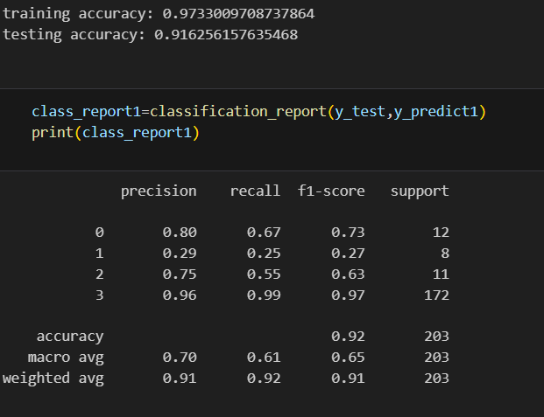
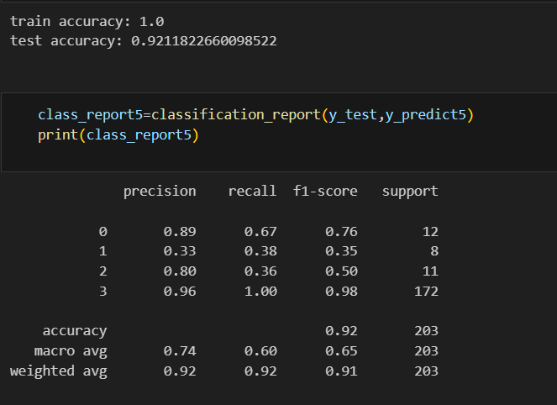
Logistic Regression
XGBM CLASSIFIER

Slide 15
Choosing Logistic Regression for Deployment
Based on the testing accuracy, the XGBoost model has the highest testing accuracy (92.1%), followed closely by Logistic Regression (91.6%). However, XGBoost is often more complex and computationally intensive compared to Logistic Regression.
Reasons for Choosing Logistic Regression:
Simplicity: Logistic Regression is simpler to implement and interpret, making it easier to deploy and maintain.
High Testing Accuracy: While not the absolute highest, Logistic Regression's testing accuracy is competitive (91.6%), indicating strong generalization to new data.
Avoids Overfitting: Unlike models like Decision Trees, which show signs of overfitting (100% training accuracy vs. lower testing accuracy), Logistic Regression provides a more balanced performance across training and testing data.

Slide 16
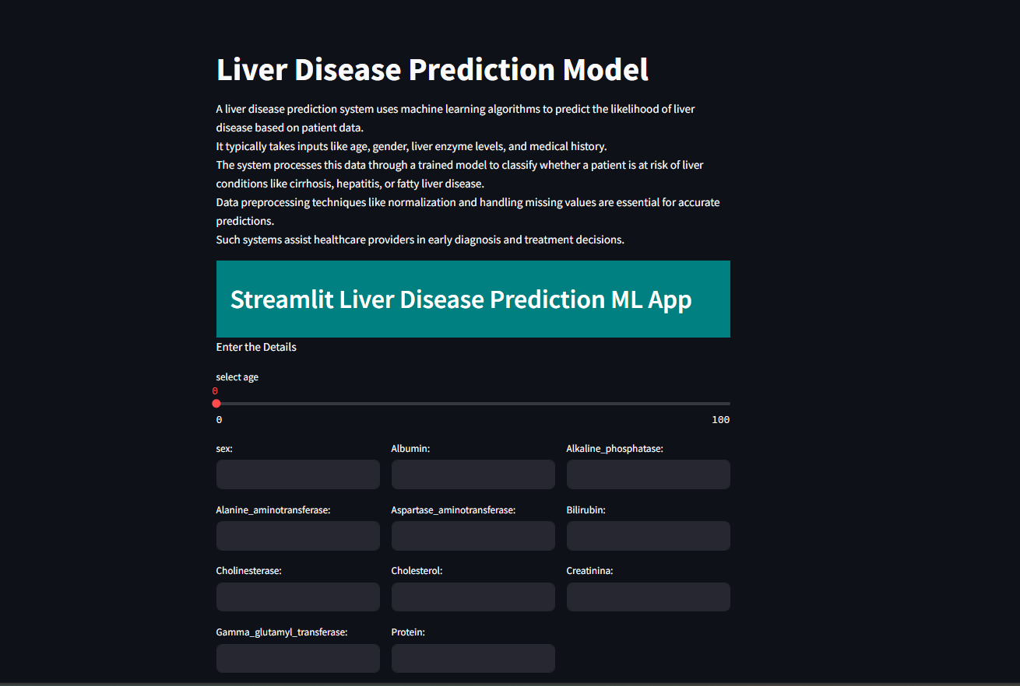
MODEL DEPLOYMENT

Slide 17
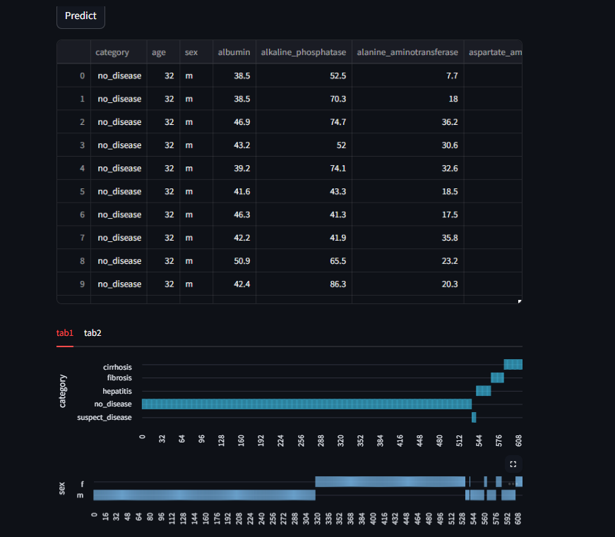
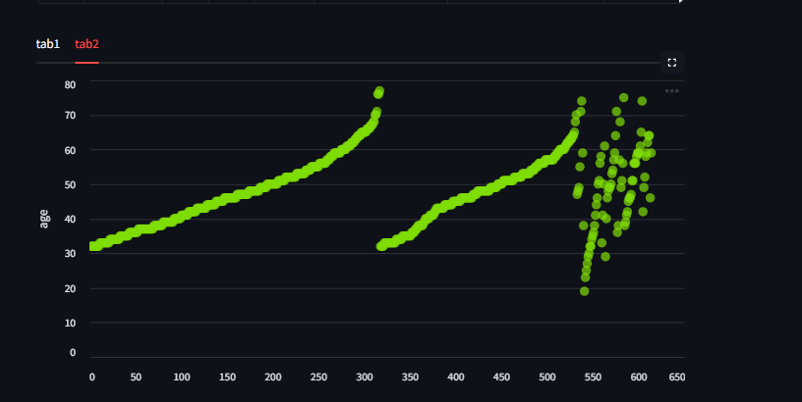

Slide 18
Challenges we faced
Data preprocessing were challenging to use
How we come over it?
To address this challenge, used techniques like imputation to fill in missing data,. also, we consider using outlier detection techniques to identify and remove outliers.

Slide 19
THANK YOU!

